Slide 1
How species interact with each other
“As more individuals are produced than can possibly survive,
there must be a Struggle for existence, either one Individual
with another of the same species Or with the Individuals of
distinct species, or with the physical conditions of life”
- Charles Darwin
Understanding Populations : Section 2

Slide 2
What’s the Difference between Lions in a Zoo and Lions in the Wild?
In the wild, lions are part of a community and a food web
In the African savanna, lions hunt zebras, fight hyenas, and are fed upon by fleas and ticks
Interactions like these are part of the evolution of the lions you see in zoos

Slide 3
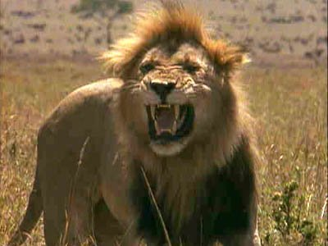
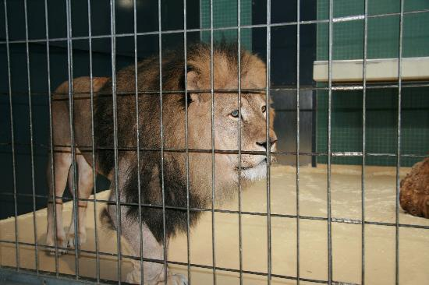
Lions

Slide 4
An Organism’s Niche
Niche- the unique role of a species within an ecosystem
A niche includes:
Physical home
Environmental factors necessary for survival
Species interactions with other organisms

Slide 5
Niche vs. Habitat
A niche is different from a habitat
An organism’s habitat is a location
A niche is an organism’s pattern of use of its habitat
A niche can also be thought of as the functional role or job a species plays in the ecosystem

Slide 6
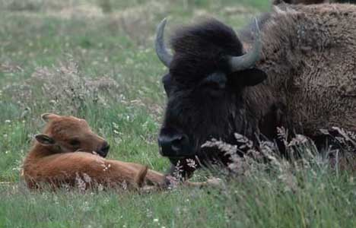
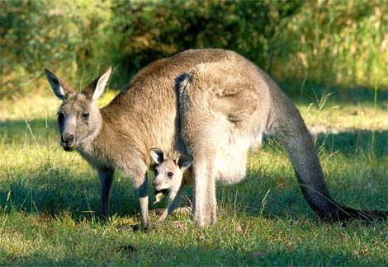
Examples of Niches
American Bison:
Large Grazing Herbivore
Utilizes American Grasslands
Kangaroos:
Herbivore
Utilizes Australian Grassland

Slide 7
Ways in Which Species Interact
There are five major ways in which species interact:
Competition
Predation
Parasitism
Mutualism
Commensalism

Slide 8
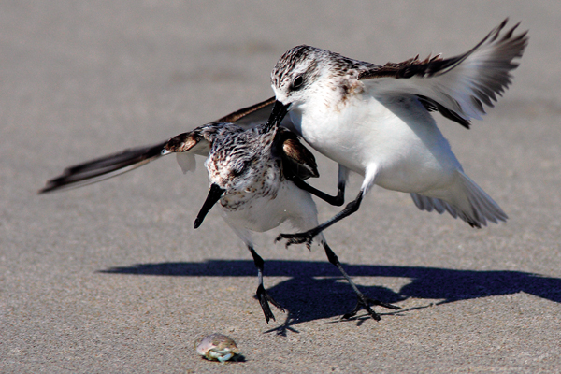
Competition
Competition- a relationship in which different individuals or populations attempt to use the same limited resource
Each individual has less access to the resource and is harmed by the competition
For most organisms, competition occurs on a daily basis

Slide 9
Competition
Competition can occur within and between species
When members of different species compete, we say their niches overlap, which means that both species use some of the same resources in a habitat

Slide 10
Indirect Competition
Species can compete even if they never come into direct contact with each other
Ex. One species feeds on a plant during the day; another species feeds on the same plant at night
Because they use the same food source, they are indirect competitors
Humans rarely interact with insects, but we compete with them for crops!

Slide 11
Adaptations to Competition
When two species with similar niches are placed together in the same ecosystem, we might expect one species to be more successful
Adaptations that decrease competition will also be advantageous for species whose niches overlap
Ex. Coyotes

Slide 12
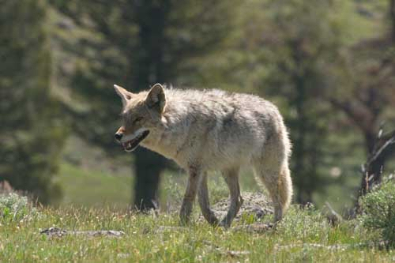
Coyotes
Coyotes live in a wide range of habitats
They are willing to get close to human settlements
They eat a wider range of plants and animals
Thus, they have a broad and varied niche
They take advantage of those parts of their niche that are easiest to use and that present least less competition

Slide 13
Niche Restriction
Occurs when each species uses less of the niche than is capable of using
It is observed when closely related species use the same limited resources within a habitat

Slide 14
Predation
Predation- an interaction between two organisms in which one organism, the predator, kills and feeds on the other organism
Ex. Snakes eating mice
Bats eating insects
Most organisms have evolved some mechanisms to avoid or defend against some predators

Slide 15
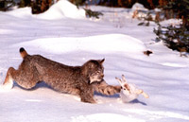
Canadian lynx vs. Snowshoe hare
The Canadian lynx feeds only on snowshoe hares
In this kind of relationship, the sizes of each population tend to increase and decrease in linked patterns

Slide 16
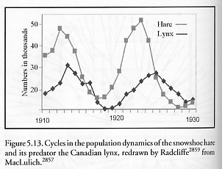
Canadian Lynx vs. Snowshoe Hare

Slide 17
Parasitism
Parasitism- a relationship between two species in which one species, the parasite, benefits from the other species, the host, which is harmed
Ex.:
Ticks
Fleas
Tapeworms
Leeches
mistletoe

Slide 18
Mutualism
Mutualism- a relationship between two species in which both species benefit
Certain bacteria in your intestines form a mutualistic relationship with you
They breakdown food you cannot digest and produce vitamins your body cannot make
In return, the bacteria get a warm, food-rich habitat

Slide 19
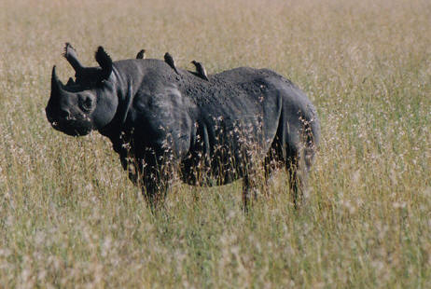
Mutualism
The Egyptian plover takes insects from the back of the rhinoceros

Slide 20
Commensalism
Commensalism- a relationship in which one species benefits and the other is neither helped nor harmed

Slide 21
Symbiosis and Coevolution
Symbiosis- a relationship in which two different organisms live in close association with each other
Symbiosis is most often used to describe a relationship in which at least one organism benefits
Over time, species in a close relationship may coevolve; they evolve adaptations that reduce the harm or improve the benefit of the relationship

