Slide 1
Chapter 7 Aquatic Ecosystems
Environmental Science

Slide 2
ENV CHAPTER 7-1: FRESHWATER ECOSYSTEMS
The kinds of things that live in an aquatic ecosystem are mainly determined by the water’s salinity – the amount of salt in the water.
Freshwater – no salt – lakes, ponds, rivers, streams, wetlands
Saltwater (marine) – salt – marshes, swamps, reefs, oceans
Temperature, amount of oxygen, and nutrients determine which organisms live where

Slide 3
Freshwater

Slide 4
There are 3 groups of aquatic organisms:
1. Plankton – tiny organisms that float near the surface of the water (cannot swim against current… known as drifters)
a. phytoplankton – plants – producers of the aquatic ecosystem
b. zooplankton – animals
2. Nekton – free-swimming organisms like fish, turtles, whales.
3. Benthos – bottom-dwellers like mussels and worms. Often live attached to things.

Slide 5
Lakes and Ponds
Can be structured into horizontal and vertical zones:
1. Littoral zone – nutrient-rich, near the shore, lots of light, life is diverse and abundant
Plants (cattails and reeds are rooted in the mud underwater while their stems and upper leaves emerge above the water)
2. Benthic zone – bottom, cooler, darker water, lots of decaying material and decomposers
Inhabited by decomposers, insect larvae, and clams
Animals that live in the different regions have adaptations that allow them to do well there.
Water beetles use the hairs under their bodies to trap surface air so that they can breathe during dives for food.
Whiskers help catfish sense food as they swim in the dark lake bottoms
Amphibians – adaptations?

Slide 6
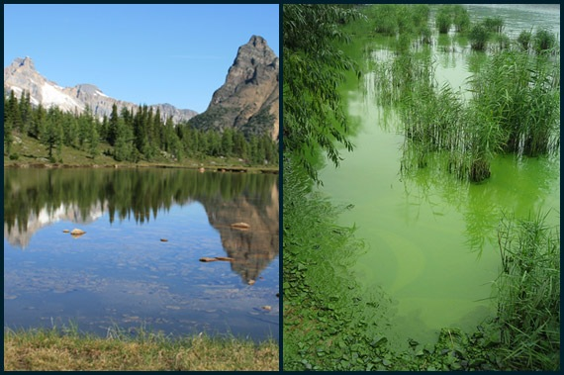
Nutrients affect lakes…
Eutrophication – an increase in the amount of nutrients in an aquatic ecosystem.
If there are lots of nutrients, there are lots of plants, then decaying things, and bacteria. The bacteria use a lot of the O2 and eventually suffocate the orgs that need O2.
Eutrophication is accelerated by runoff that contains fertilizers, waste, etc.

Slide 7
Freshwater Wetlands
Areas of land covered w/ fresh water for at least part of the year – marshes and swamps.
Most are located in the southeast US. Occur on low, flat lands.
1. marshes – contain non-woody plants (cattails). Benthic zones are nutrient rich, contain plants, decomposers and scavengers
Water fowl have adaptations (flat beaks/spearlike beaks)
-brackish – has slightly salty water
-salt marshes – saltier water
2. swamps – dominated by woody plants (trees and shrubs). Occur on flat, poorly drained land often near streams
Species of trees/shrubs depend upon salinity of the water
Amphibians/birds/American alligator

Slide 8
Important Environmental Functions of Wetlands
-they act like filters – they remove pollutants from water that flows through them and improve the quality of water downstream
-control flooding – they absorb extra water when rivers overflow
-many fish species use these areas for feeding and spawning
- they provide homes for migratory animals
- the vegetation traps C which would otherwise be released as CO2 into the atmosphere

Slide 10
Wetlands

Slide 11
Human Impact on Wetlands
Wetlands were previously considered to be wastelands that provide breeding grounds for disease-carrying insects.
Many have been drained, filled, and cleared for farms or residential and commercial development.
FLORIDA EVERGLADES: once covered 8 million acres of south Florida – now only covers 2 million acres.
Important role of wetlands as purifiers or wastewater and in flood prevention is now recognized.
Many states and the federal government now have laws to protect and prohibit the destruction of certain wetlands.

Slide 12
Rivers
Many originate from snow melt in the mountains.
-at the head (where it starts) – water is colder, full of O2, runs fast, and the riverbed is shallow
-downstream – becomes wider, warmer, slower, less O2
A river changes w/ the land and climate it goes through. Runoff from the surrounding land also affects the river.

Slide 13
Life in a River
Near the beginning – mosses anchored by rhizoids, trout, minnows, no plankton b/c the current is too strong
Farther down – plankton, plants, lots of sediment, and other fish.
Catfish and carp also live in the calmer waters.
Rivers are in danger from industries dumping in them, runoff of pollutants, dams that alter the ecosystem.

Slide 14
ENV CHAPTER 7-2: MARINE ECOSYSTEMS
Marine ecosystems are located in costal areas and open oceans
-Costal – organisms adapt to different water levels and salt levels
-Ocean – organisms adapt to diff temps, sunlight, nutrients

Slide 15
Coastal Wetlands
areas covered by salt water for all or part of the time
- provide habitat for fish and wildlife
-absorb excess rain to prevent flooding
- filter the water
- provide recreation areas

Slide 16
Estuaries
where freshwater from a river mixes w/ salt water from the ocean
- They are very productive ecosystems b/c they constantly receive fresh nutrients form the river and ocean.
The surrounding land protects the estuary from the force of ocean waves
They support many orgs b/c the water is shallow and so receives plenty of light for photosynthesis, and there are plenty of nutrients.
- Organisms that live there are able to tolerate variations in salinity b/c the salt content of the water varies as fresh and salt water mix and as tides go in and out.
- threatened by pollution from sewage, industrial waste, agricultural runoff.

Slide 17
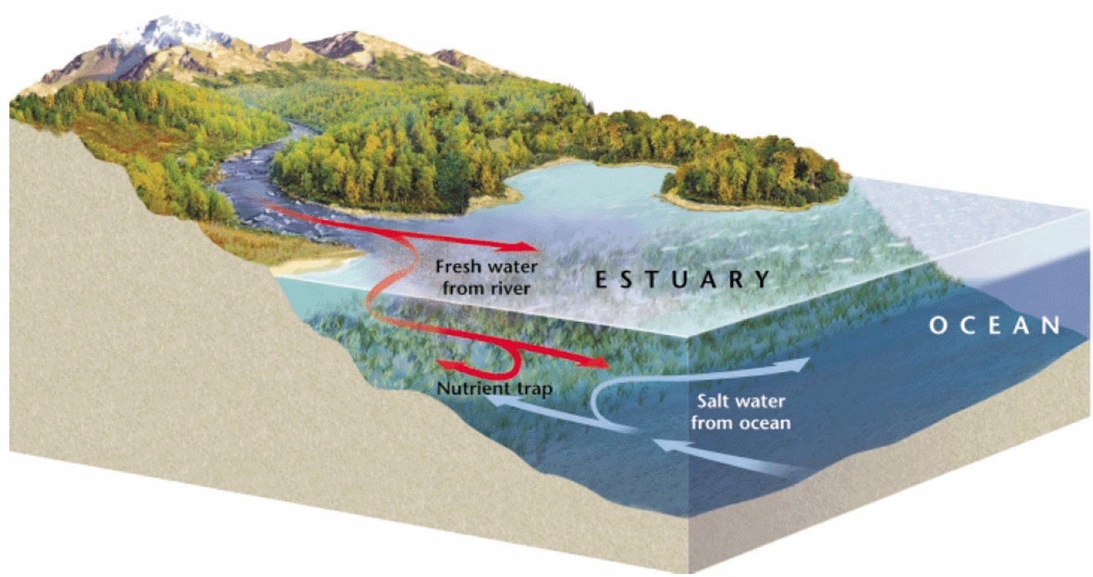

Slide 18
Salt Marshes
along the Gulf of Mexico and the Atlantic coast.
-they develop in estuaries where rivers deposit mineral-rich mud.
-Dominated by marsh grasses.
-Provide breeding and feeding grounds.

Slide 19
Mangrove Swamps
along the coastal areas of tropical and subtropical zones.
-Dominated by mangrove trees.
-Help prevent erosion and damage from storms.

Slide 20
Rocky and Sandy Shores
Rocky shores have more plants.
Sandy shores dry out when the tide goes out
Barrier islands run parallel to the shore and help protect the mainland and coastal wetlands.

Slide 21
Coral Reefs
Limestone ridges built by tiny coral animals called coral polyps that secrete limestone skeletons.
-Are among the most diverse ecosystems
- Live in clear warm salt water where there is plenty of light for photosynthesis – so in shallow tropical seas.
-The reef forms cracks and crevices that act as habitats for tons of orgs
- Fragile ecosystems – extremely sensitive to temperature, nutrient level, disturbance.

Slide 22
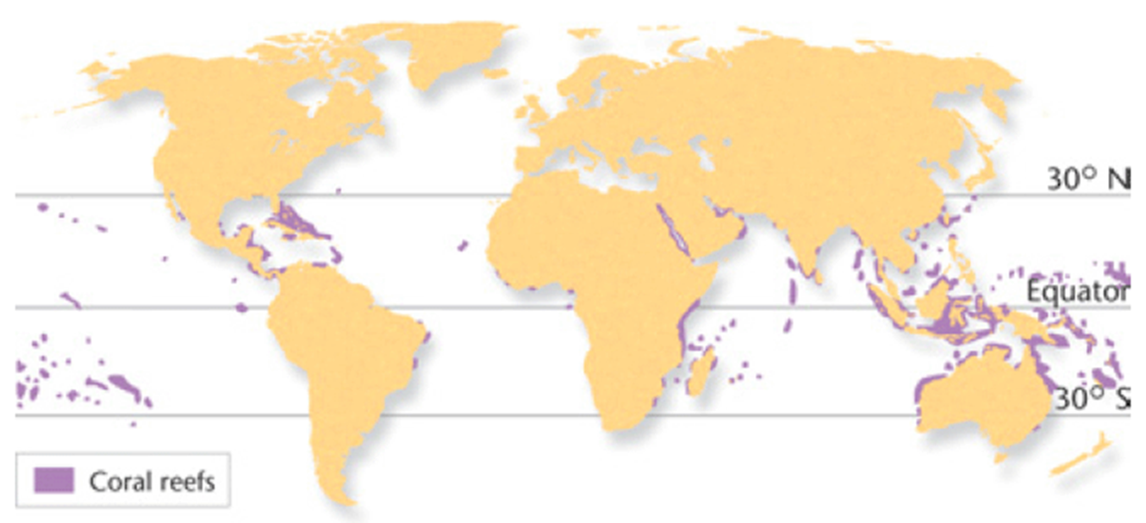

Slide 23
Oceans
- Most of the life is in the shallow coastal waters b/c that’s where all the light is (remember producers need light for photosynthesis)
so producers and the consumers that eat them are all concentrated there.
- Phytoplankton, zooplankton, fish, marine mammals live there.
- As a result, open ocean is among the least productive ecosystems.
- Deep in the ocean it’s dark so most food consists of dead things that fall from the surface.
- Decomposers, filter-feeders and the orgs that eat them live on the bottom.
-Threats – pollution, overfishing

Slide 24
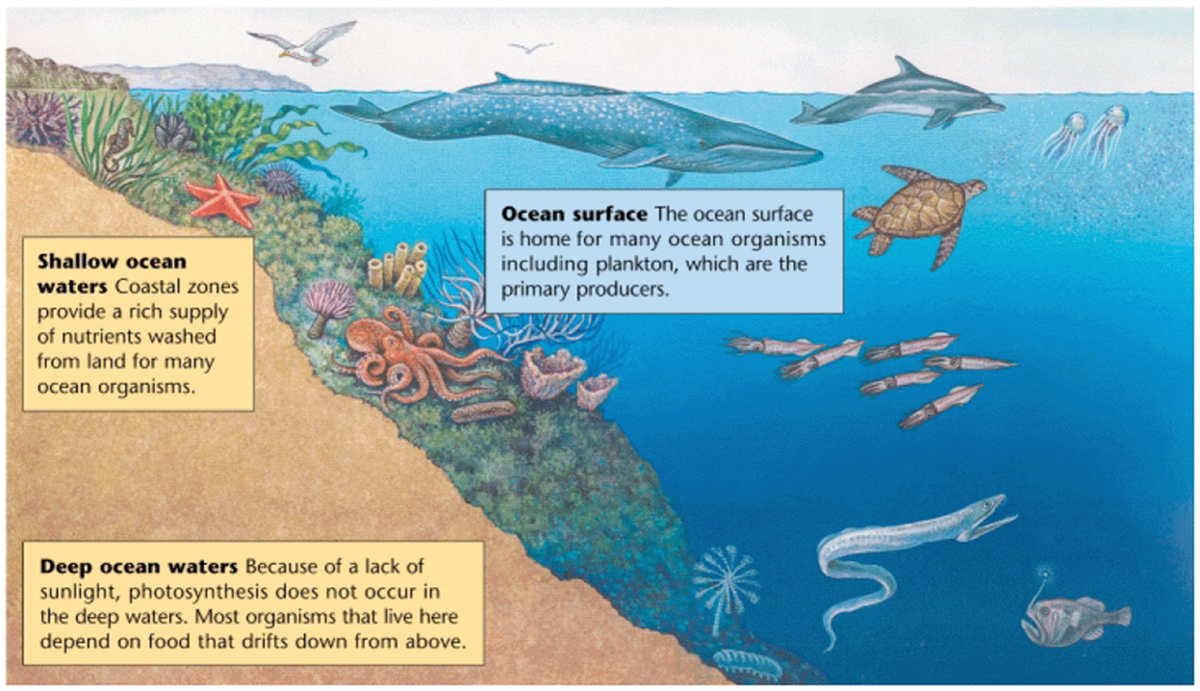

Slide 25
Arctic and Antarctic Ecosystems
depend on marine ecosystems b/c nearly all the food comes from the ocean.
Too cold for plants to grow so the plankton are the producers that start off the food chain.

