Slide 1
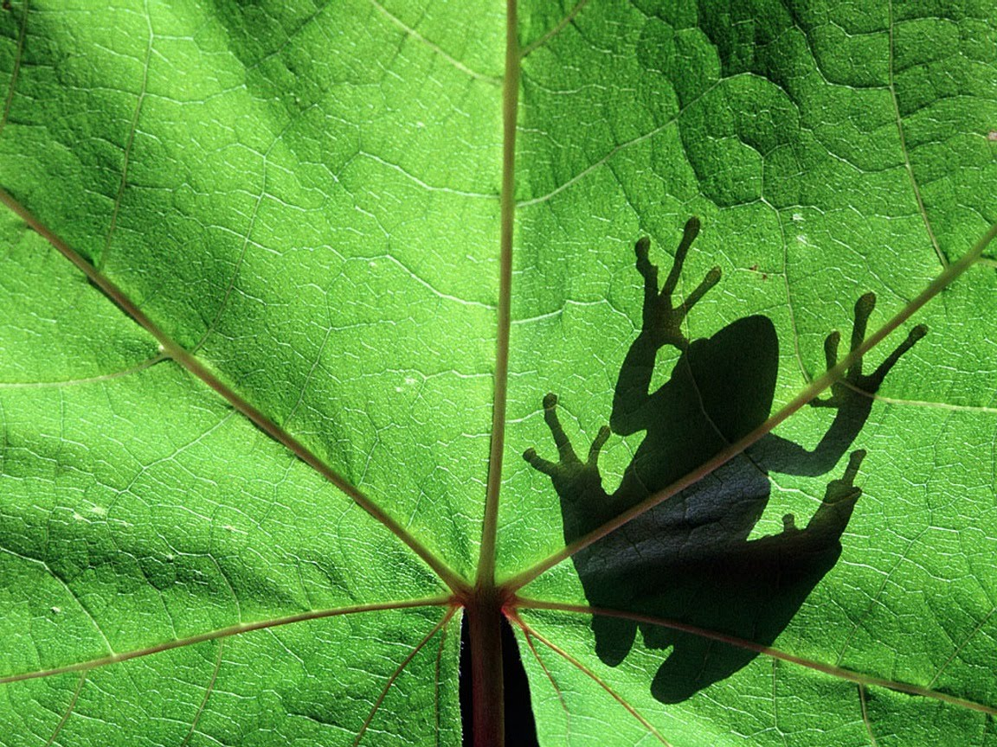
The Future of Biodiversity

Slide 2
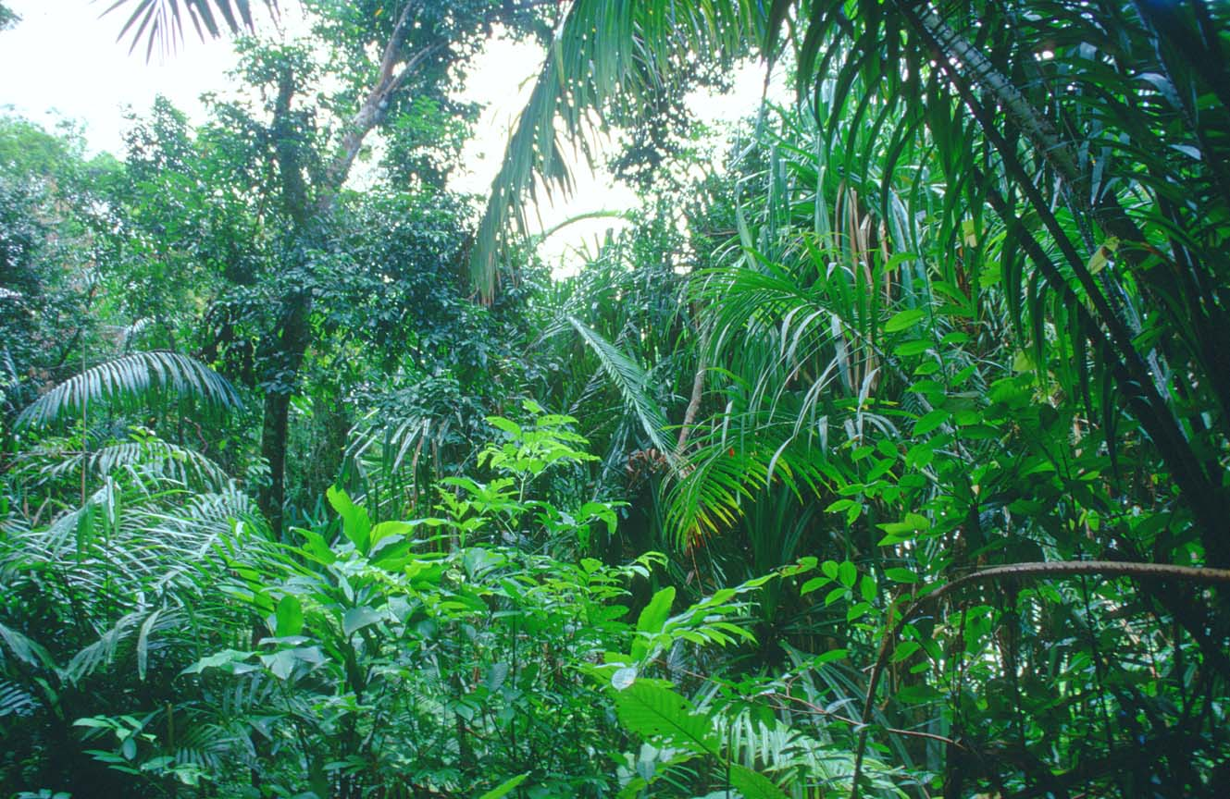
Objectives
List and describe four types of efforts to save individual species.
Explain the advantages of protecting entire ecosystems rather than individual species.
Describe the main provisions of the Endangered Species Act.
Discuss ways in which efforts to protect endangered species can lead to controversy.
Describe three examples of worldwide cooperative efforts to prevent extinctions.

Slide 3
Saving One Species at a Time
People are making efforts to slow the loss of species and conserve ecosystems.
Here are 3 ways we are trying to save species One Species at a Time.

Slide 4
Captive-Breeding Programs
Captive breeding- breeding species in captivity with the hope of re-introducing populations to their natural habitats. The big question is whether the populations will ever reproduce in the wild.

Slide 5
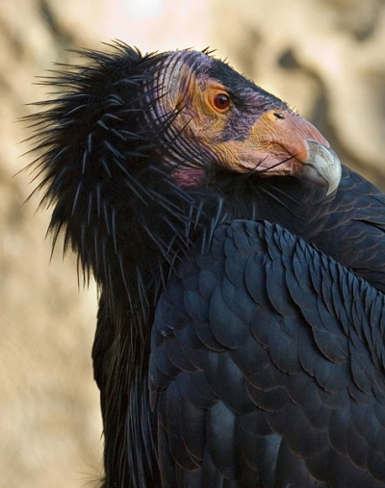
Captive-Breeding Program
The California Condor was on the brink of extinction with its numbers dropping to less than 25. They are still endangered, but conservation efforts have paid off. Last count there were 356 California Condors in existence with 180 of them flying free.

Slide 6
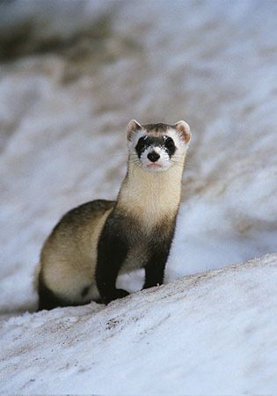
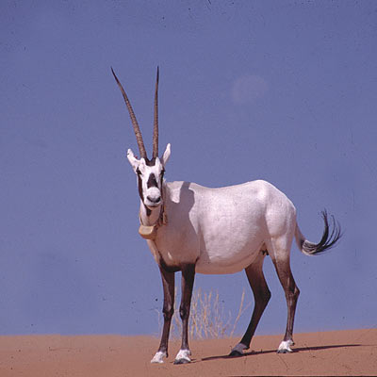
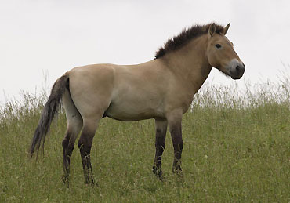
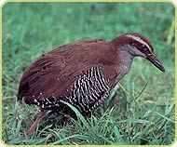

Slide 7
Preserving Genetic Material
Genetic material is preserved by making a germ plasm bank.
  Germ plasm is genetic material from the reproductive cells of animals- seeds, sperm, eggs or pure DNA.

Slide 8
Zoos, Aquariums, Parks and Gardens
Were started to display exotic animals.
They are now living museums of biodiversity.
They are many species last hope for survival.

Slide 9
More Study Needed
Ultimately, saving a few individuals does little to preserve a species as captive species may not reproduce or survive again in the wild.
Also, small populations are vulnerable to infectious diseases and genetic disorders caused by inbreeding.

Slide 10
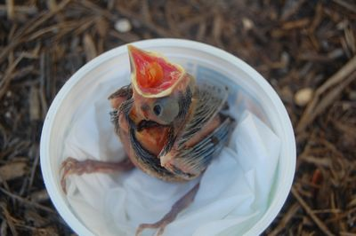
Fact or Fiction
Baby bird stolen from nest for illegal bird trade.

Slide 11
Preserving Habitats and Ecosystems
The best thing is to preserve whole habitats and ecosystems- not just a single species.
Everything is connected- protecting entire ecosystems may help save many species and will maintain ecosystem functions.

Slide 12
How to Preserve Whole Habitats and Ecosystems?
Identify native habitats that can be preserved, restored, and linked to large networks.
Promote products that have been harvested or produced with sustainable practices.

Slide 13
Legal Protection for Species
The US has some of the strongest laws to protect species from becoming extinct.
The Endangered Species Act is a federal law to protect plant and animal species in danger of extinction.

Slide 14
Four main parts of the Endangered Species Act
1. US Fish and Wildlife Service(USFWS) has to make a list of all the endangered and threatened species.
2. Endangered and threatened species may not be caught, killed, uprooted, sold, or traded.
3. The Federal Government may not carry out any project that jeopardizes the endangered species.

Slide 15
Endangered Species Act
The USFWS must make a recovery plan for each endangered or threatened species.
- species recovery plans often propose to protect or restore habitat
- However, attempts to restrict human uses of land can be controversial. Real-estate developers may be prohibited from building in certain areas, and people may lose income and may object when their interests are placed below those of another species.

Slide 16
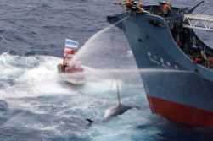
Fact or Fiction?
Greenpeace trying to stop illegal whaling.

Slide 17
Habitat Conservation Plan
(Biodiversity or Bucks?)
Battles between environmentalists and developers are widely publicized, and in most cases, compromises are eventually worked out. One form of compromise is a habitat conservation plan.
A habitat conservation plan is a land-use plan that attempts to protect threatened or endangered species across a given area by allowing some tradeoffs between harm to the species and additional conservation commitments among cooperating parties.

Slide 18
International Cooperation
At the global level, the International Union for the Conservation of Nature and Natural Resources (IUCN) facilitates efforts to protect species and habitats.
The IUCN publishes Red Lists of species in danger of extinction around the world, advises governments on ways to manage their natural resources, and works with wildlife groups.

Slide 19
International Cooperation
One product of the IUCN has been an international treaty called CITES (the Convention on International Trade in Endangered Species).
The CITES treaty was the first effective effort to stop the slaughter of African elephants being killed by poachers who would then sell the ivory tusks.
In 1989, the members of CITES proposed a total worldwide ban on all sales, imports, and exports of ivory, hoping to put a stop to the problem.

Slide 20
International Cooperation
Some people worried that making ivory illegal might increase the rate of poaching instead of decrease it.
They argued that illegal ivory, like illegal drugs, might sell for a higher price.
But after the ban was enacted, the price of ivory dropped, and elephant poaching declined dramatically.

Slide 21
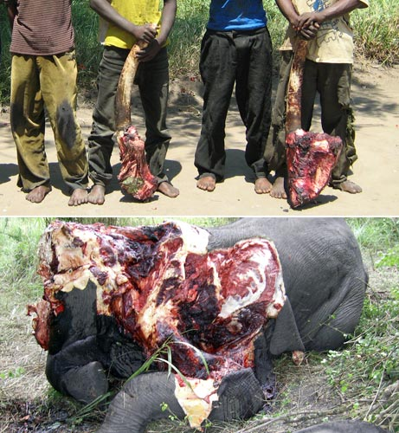
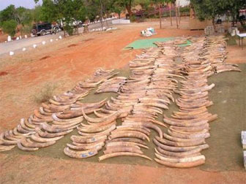
International Cooperation

Slide 22
The Biodiversity Treaty
The treaty’s goal is to preserve biodiversity and ensure the sustainable and fair use of genetic resources in all countries.

Slide 23
Biodiversity or Bucks?
Some political groups objected to the treaty, especially to the suggestion that economic and trade agreements should take into account any impacts on biodiversity that might result from the agreements.

Slide 24
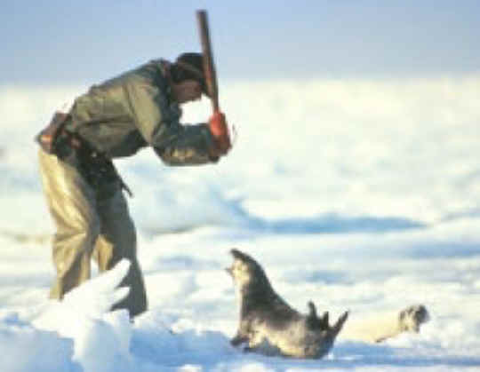
Fact or Fiction?
Baby seal being clubbed to death for its fur.

Slide 25
Private Conservation Efforts
Many private organizations work to protect species worldwide, often more effectively than government agencies.
For example, the World Wildlife Fund encourages the sustainable use of resources and supports wildlife protection. The Nature Conservancy has helped purchase millions of hectares of habitat preserves in 29 countries. Conservation International helps identify biodiversity hotspots. And, Greenpeace International organizes direct and sometimes confrontational actions.

Slide 26
Balancing Human Needs
Attempts to protect species often come into conflict with the interests of the world’s human inhabitants.
An endangered species might represent a source of food or income. Or a given species may not seem valuable to those who do not understand the species’ role in an ecosystem.
Many conservationists feel than an important part of protecting species is making the value of biodiversity understood by more people.

